Slide 1





Slide 2



















Slide 3










Slide 4






Slide 5
















Slide 6










Slide 7


















Slide 9
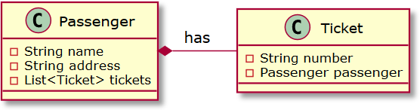

Slide 10

public class Passenger { private String name; private String address;
private List<Ticket> tickets;
}
public class Ticket { private String number;
private Passenger passenger;
}

Slide 11

create table PASSENGERS (
NAME varchar(255), ADDRESS varchar(255), primary key (NAME)
)
create table TICKETS (
NUMBER varchar(255), PASSENGER_NAME varchar(255),
primary key (NUMBER)
)
alter table TICKETS
add constraint FK_PASSENGERS foreign key (PASSENGER_NAME) references PASSENGERS (NAME)

Slide 12
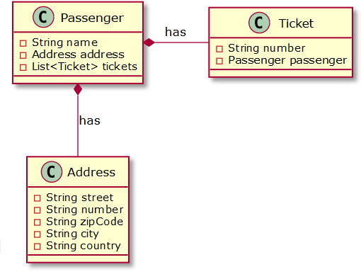

Slide 13

create table PASSENGERS (
NAME varchar(255), ADDRESS_STREET varchar(30), ADDRESS_NUMBER varchar(6), ADDRESS_ZIPCODE varchar(10),
ADDRESS_CITY varchar(25), ADDRESS_COUNTRY varchar(25),
primary key (NAME)
)

Slide 15

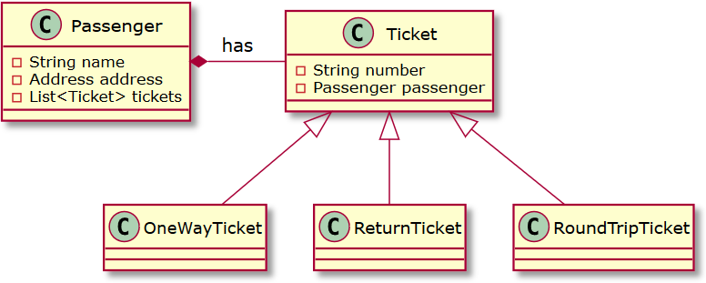

Slide 16


Slide 17
create table PASSENGERS (
NAME varchar(255), ADDRESS_STREET varchar(30), ADDRESS_NUMBER varchar(6), ADDRESS_ZIPCODE varchar(10),
ADDRESS_CITY varchar(25), ADDRESS_COUNTRY varchar(25),
primary key (NAME)
)

Slide 18






Slide 19
create table PASSENGERS ( ID integer not null, NAME varchar(255), primary key (ID)
)
create table TICKETS (
ID integer not null, NUMBER varchar(255), PASSENGER_ID integer, primary key (ID)
)
alter table TICKETS
add constraint FK_PASSENGERS foreign key (PASSENGER_ID) references PASSENGERS (ID)

Slide 21


Slide 22



create table PASSENGERS ( ID integer not null, NAME varchar(255),
ADDRESS_STREET varchar(30), ADDRESS_NUMBER varchar(6), ADDRESS_ZIPCODE varchar(10),
ADDRESS_CITY varchar(25), ADDRESS_COUNTRY varchar(25),
primary key (ID)
)
create table TICKETS (
ID integer not null, NUMBER varchar(255), PASSENGER_ID integer, primary key (ID)
)

Slide 24
create table PASSENGERS ( ID integer not null, NAME varchar(255),
ADDRESS_STREET varchar(30), ADDRESS_NUMBER varchar(6), ADDRESS_ZIPCODE varchar(10),
ADDRESS_CITY varchar(25), ADDRESS_COUNTRY varchar(25),
primary key (ID)
)
create table TICKETS (
ID integer not null, NUMBER varchar(255), PASSENGER_ID integer, primary key (ID)
)

Slide 25

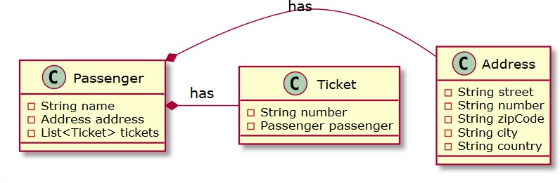

Slide 26




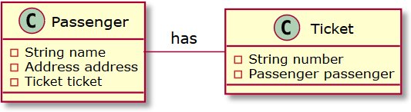

Slide 27



Slide 28


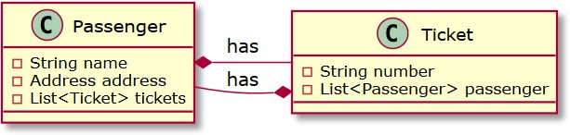

Slide 29
create table PASSENGERS ( ID integer not null, NAME varchar(255),
ADDRESS_STREET varchar(30), ADDRESS_NUMBER varchar(6), ADDRESS_ZIPCODE varchar(10),
ADDRESS_CITY varchar(25), ADDRESS_COUNTRY varchar(25),
primary key (ID)
)
create table TICKETS (
ID integer not null, NUMBER varchar(255), PASSENGER_ID integer, primary key (ID)
)

Slide 30



create table PASSENGERS_TICKETS (
PASSENGER_ID integer not null,
TICKET_ID integer not null,
primary key (PASSENGER_ID, TICKET_ID)
)
alter table PASSENGERS_TICKETS
add constraint FK_PASSENGERS foreign key (PASSENGER_ID) references PASSENGERS (ID)
alter table PASSENGERS_TICKETS add constraint FK_TICKETS foreign key (TICKET_ID) references TICKETS (ID)

Slide 32




Slide 33
create table PASSENGERS ( ID integer not null, NAME varchar(255),
ADDRESS_STREET varchar(30), ADDRESS_NUMBER varchar(6), ADDRESS_ZIPCODE varchar(10),
ADDRESS_CITY varchar(25), ADDRESS_COUNTRY varchar(25),
primary key (ID)
)
create table TICKETS (
ID integer not null, NUMBER varchar(255), PASSENGER_ID integer, primary key (ID)
)

Slide 34
for(Ticket ticket: passenger.getTickets())
SELECT * FROM PASSENGERS WHERE ID = 727423
SELECT * FROM PASSENGERS, TICKETS WHERE PASSENGERS.ID = 727423 AND PASSENGERS.ID = TICKETS.PASSENGER_ID

Slide 35

Overview of ORM tools

Slide 36















Slide 37











-
-

